Slide 1
FiBEROPTIC INTUBATION 101: An overview
Erica Jones, DNP, APRN, CRNA

Slide 2

Agenda
Introduction to FOI
Indications
Contraindications
Advantages
Complications & Possible Challenges
Approaches
Steps to Perform
Final Tips & Key Takeaways

Slide 3
Introduction to foi
What is fiberoptic intubation?
Fiberoptic intubation (FOI) involves the placement of an endotracheal tube (ETT) into the trachea under direct visualization by utilizing a flexible fiberoptic bronchoscope.
FOI is the gold standard for securing a difficult airway, particularly when the goal is to maintain spontaneous ventilation.
(Miller, R.D. et al., 2020)

Slide 4
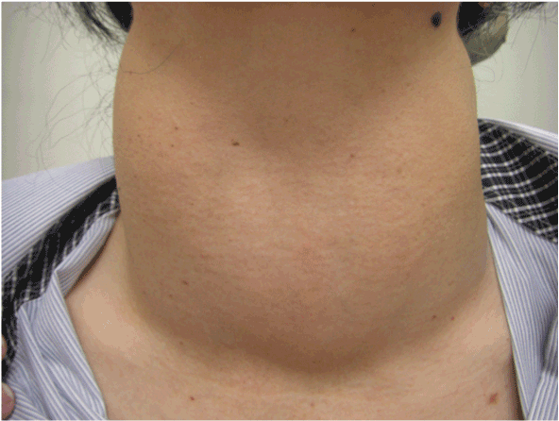
INDICATIONS
If difficult airway is anticipated, especially when the following are present:
Anatomical anomalies/Congenital abnormalities
Restricted mouth opening
Cervical spine immobility
Facial trauma
Morbid obesity
Upper airway tumors
(Apfelbaum, J.L.,et al., 2022)

Slide 5

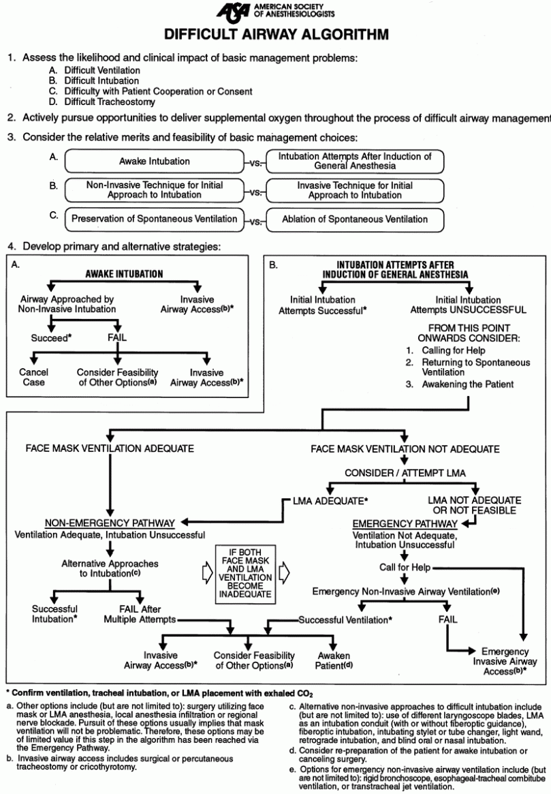

ASA Difficult airway algorithm

Slide 6
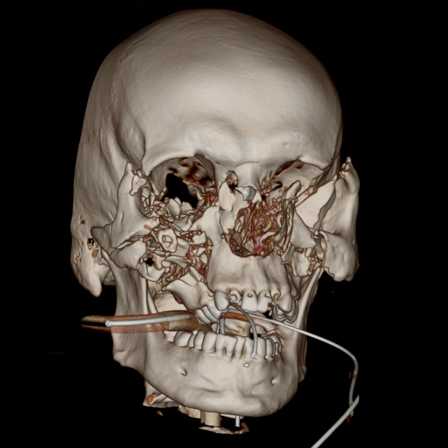
Contraindications
Uncontrolled bleeding
Copious secretions
Severe airway obstruction
Lack of patient cooperation
Inability to topically anesthetize the airway
Severe facial or nasal trauma (if considering nasal route)
Limited operator experience (in high risk situations)
(Benumof, J.L., 2007)

Slide 7

ADvantages
Maintains spontaneous ventilation
Minimal cervical spine movement
Ideal for awake intubation
High success rates in anticipated difficult airways
(Barash, P.G., et al., 2021)

Slide 8
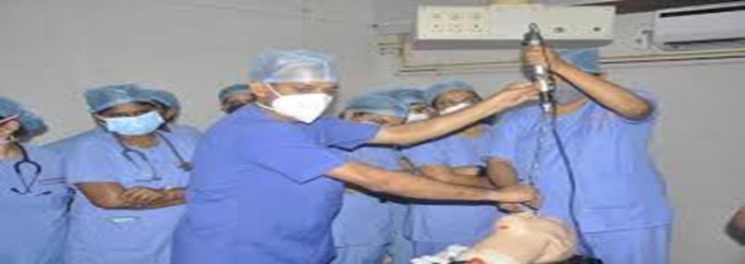
Complications & possible challenges
Hypoxia
Laryngospasm
Airway trauma
Aspiration
Hemodynamic instability
Fogging of the lens
Difficulty navigating distorted anatomy
Patient movement
(Miller, R.D. et al., 2020)

Slide 9
Approaches
Awake vs. Asleep
Awake FOI is most commonly used when difficult intubation is anticipated, great to avoid loss of airway control
Patient cooperation, topical anesthesia and light sedation are required with this approach
Asleep FOI is reserved for patients where awake FOI is not feasible
An assurance of the ability to ventilate a patient via mask or supraglottic airway device prior to asleep FOI
Nasal vs. Oral
Nasal route is preferred in awake patients
Oral route is often facilitated utilizing an OPA to help guide the scope and maintain airway patency
(Miller, R.D. et al., 2020)

Slide 10
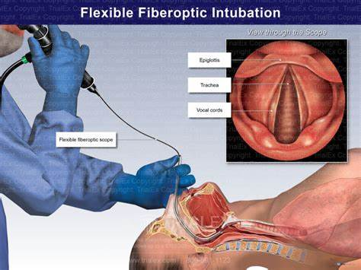
Steps to perform
Pre-procedure Preparation
Airway Topicalization
Crucial for awake approach
Scope Preparation
Intubation
Patient Video - Awake Fibreoptic Intubation - YouTube
(Apfelbaum, J.L.,et al., 2022)

Slide 11

Tips & Key takeaways
Requires expertise & practice- The more you do it, the more you build confidence!
Secretions, blood or vomitus can cause the view to be obscured
Claustrophobia or uncooperative patients may not tolerate awake FOI
Equipment must be available and functional
FOI is recommended by ASA, AANA, and DAS (Difficult Airway Society)
Regular training and simulation correlates with increased success rates
Every anesthetist should be familiar with FOI
(Apfelbaum, J.L.,et al., 2022)

Slide 12

Thank you!
MERCI BEAUCOUP!

Slide 13
references
Apfelbaum, J.L., et al. (2022). Practice Guidelines for Management of the Difficult Airway: An Updated Report by the American Society of Anesthesiologists. Anesthesiology, 136 (1), 31-81. https://doi.org/10.1097/ALN.0000000000004002
Barash, P.G., et al. (2021). Clinical Anesthesia (9th ed.) Wolters Kluwer.
Benumof, J.L. (2007). Airway Management: Principles and Practice.
Miller, R.D., et al. (2020). Miller’s Anesthesia (9th ed., Chapter 55).
Rosenblatt, W. H., & Sukhupragram, W. (2020). In R.D. Miller (Ed.), Miller’s Anesthesia (9th ed., pp. 1645-1670). Elsevier.

