Slide 1
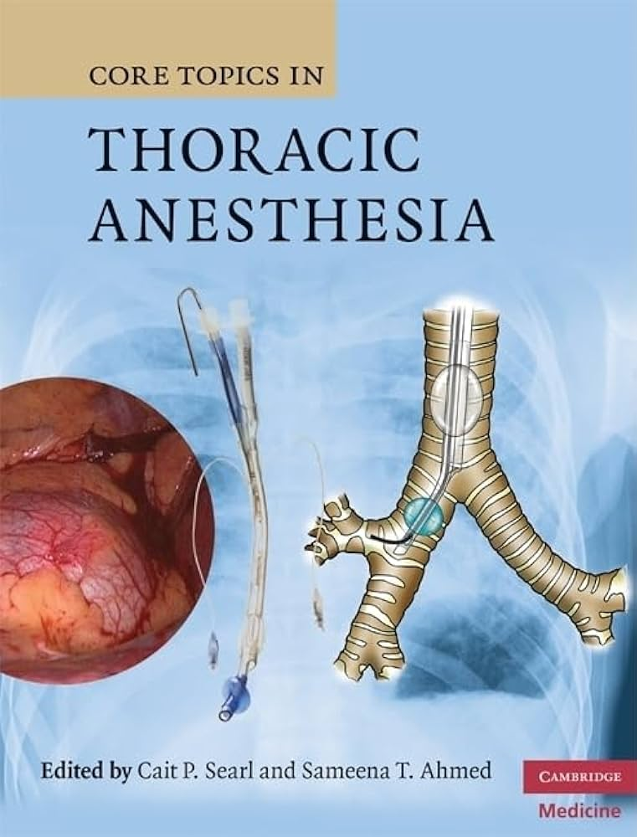
ONE LUNG VENTILATION
Jacqueline Odhiambo, DNP, CRNA

Slide 2
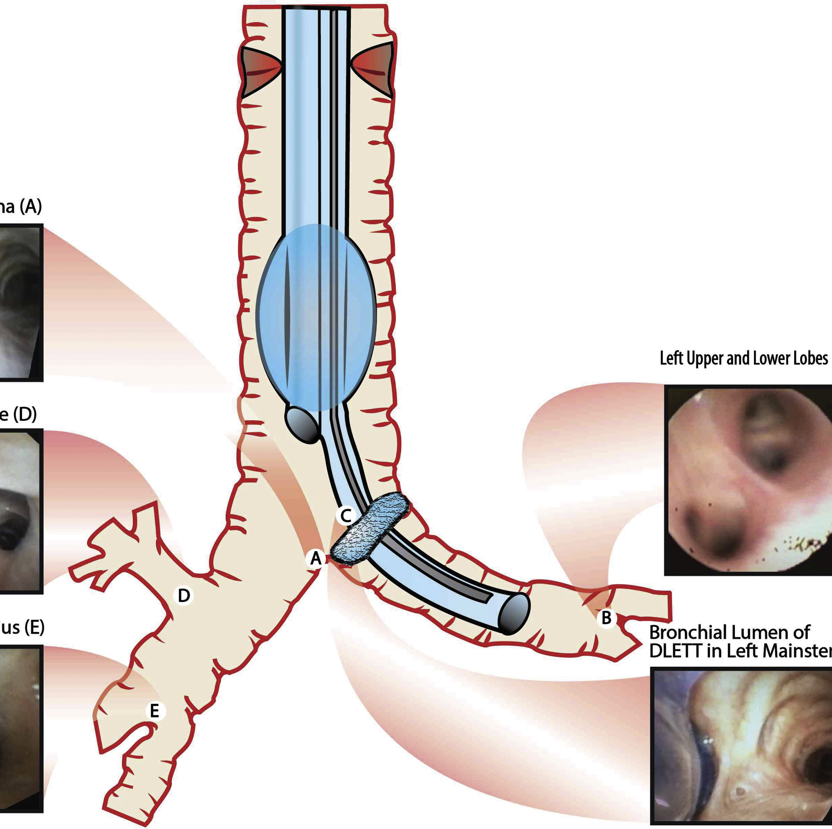
OBJECTIVES
Identify the indications of one lung ventilation
Methods of Lung Isolation
How to estimate the correct size of Double lumen tube
Advantages and Disadvantages of lung isolation techniques
Patient monitoring during one lung ventilation
Management Hypoxia during one lung ventilation
Complications of One lung Ventilation

Slide 3
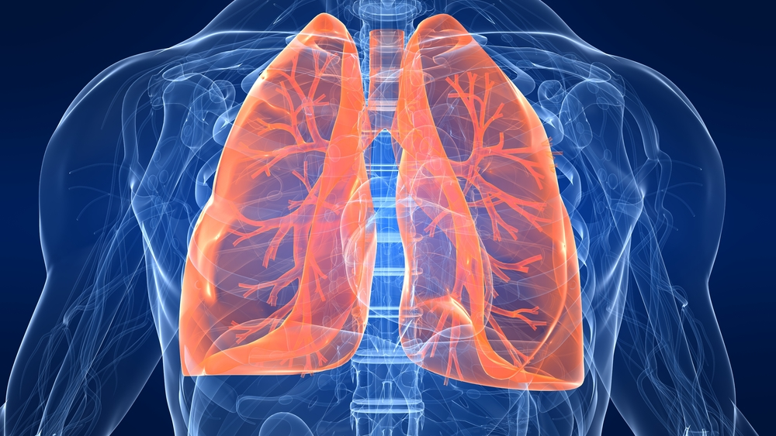
Indications for One Lung Ventilation
There are four main indications for one lung ventilation:
Isolation of the lungs
To improve surgical access
Greater control over ventilation
Unilateral bronchopulmonary lavage
Notes:
https://www.slideshare.net/slideshow/one-lung-ventilation-66637604/66637604#2

Slide 4
Absolute
Relative
Isolation of the lung from the other to avoid contamination
Infection
Massive Hemorrhage
Control of the distribution of ventilation
Bronchopleural fistula
Lung cyst or bulla
Tracheobronchial tree disruption
Life threatening hypoxemia from a unilateral lung disease
Surgical Exposure
Thoracic Aortic Aneurysm
Pneumonectomy
Upper Lobectomy
Mediastinal exposure
Esophageal resection

Slide 5
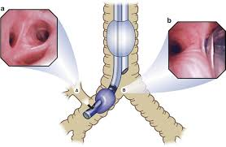
Methods of Lung Isolation
There are three basic techniques for lung isolation:
Left or right double-lumen tube( gold standard for lung isolation)
Bronchial Blockers
Arndt
Fuji
Cohen
Ez Blocker
Univent
Single lumen endotracheal tube placed in the mainstem bronchus

Slide 6
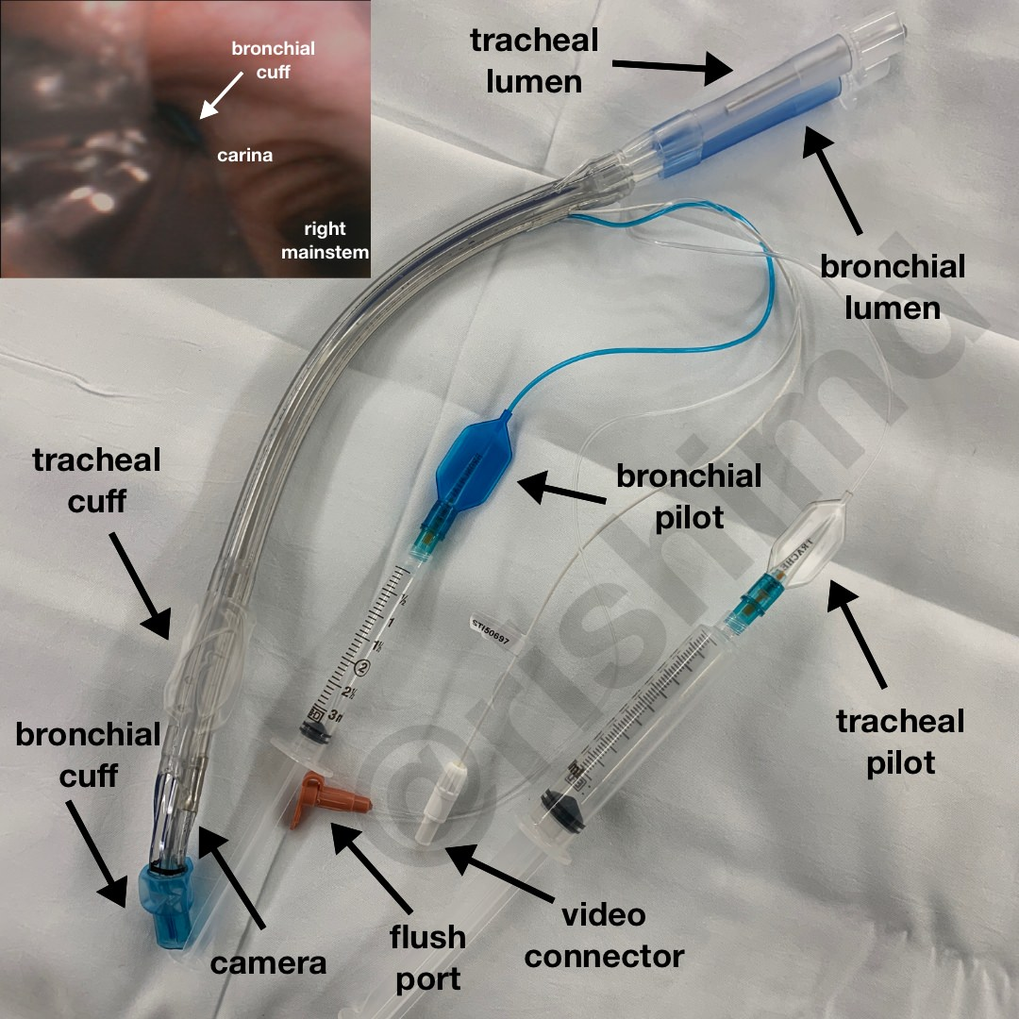
Double Lumen Endotracheal Tubes(DLT)
A DLT is bifurcated with an endotracheal and endobronchial lumen.
The two lumens are color coded:
White ~tracheal
Blue~ bronchial

Slide 7
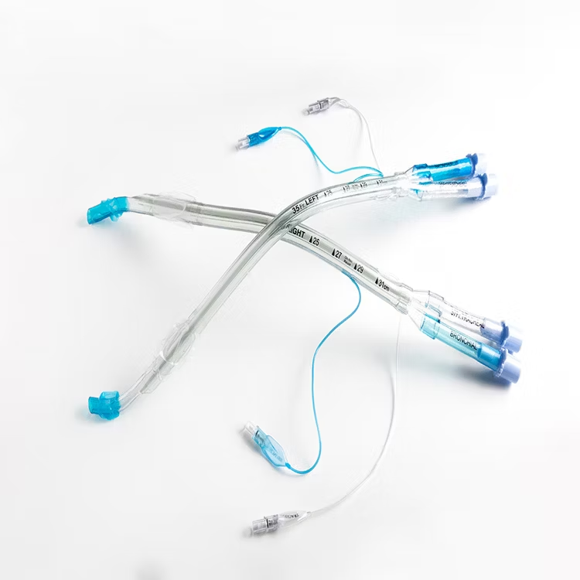
Guidelines for DLT Sizes in Adults
Gender | Height(m) | Size (Fr) | Insertion Depth (cm)
Female | <1.6 (63 in) | 35 (Possibly 32 Fr if <1.5 m) | 27
Female | >1.6 | 37 | 27
Male | <1.7 (67 in) | 39 (Possibly 37 Fr if <1.6 m) | 29
Male | >1.7 | 41 | 29
Notes:
When selecting the size of a double lumen tube (DLT), height is generally considered more relevant than weight because of its direct relationship to the depth of the tube needed for placement in the left main bronchus.
Depth of insertion of DLT. Tracheobronchial dimensions correlate with height. The average depth at insertion, from the teeth, for a left DLT is 29 cm in an adult and varies ±1 cm for each 10 cm of patient height above/below 170 cm.

Slide 8
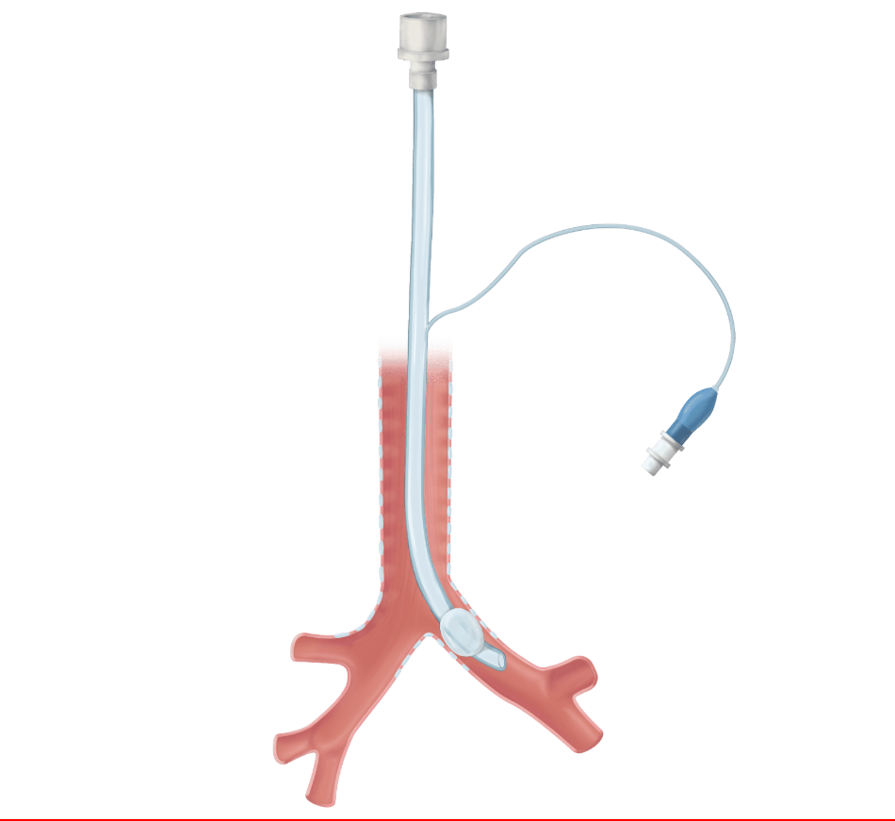
Guidelines for DLT Sizes in Children
The pediatric airway is narrow
Inserting a DLT in a narrow airway would make the resistance to airflow very high.
Children under 8 years who require lung isolation would need:
Bronchial blocker
Single lumen endotracheal tube advanced to the mainstem bronchus
Age ( years) | Size (Fr)
8-9 | 26
> 10 | 28 or 32
Notes:
When selecting the size of a double lumen tube (DLT), height is generally considered more relevant than weight because of its direct relationship to the depth of the tube needed for placement in the left main bronchus.
Depth of insertion of DLT. Tracheobronchial dimensions correlate with height. The average depth at insertion, from the teeth, for a left DLT is 29 cm in an adult and varies ±1 cm for each 10 cm of patient height above/below 170 cm.

Slide 9
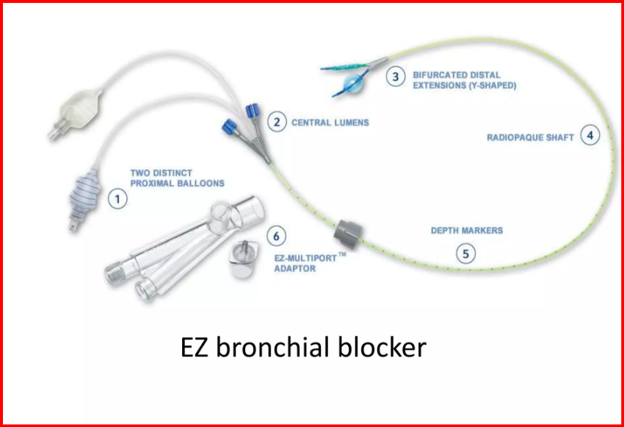
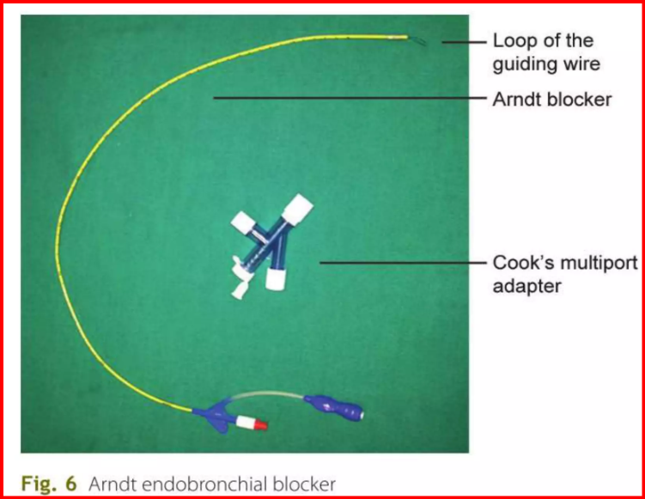
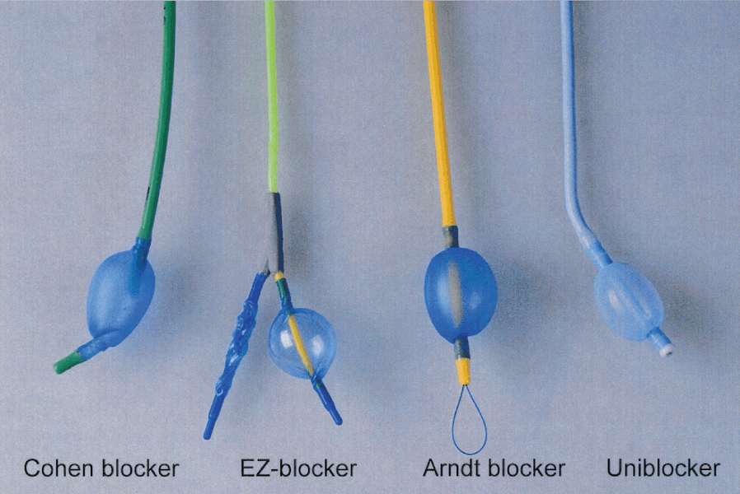
Bronchial Blockers
Can be placed in either bronchus to achieve complete isolation of the lung.
Can also be used for selective lobar blockade on the surgical side.
Bronchial blockers have a high-volume, low-pressure ballon at the tip.
Can be used to apply CPAP or suction to assist lung collapse

Slide 10
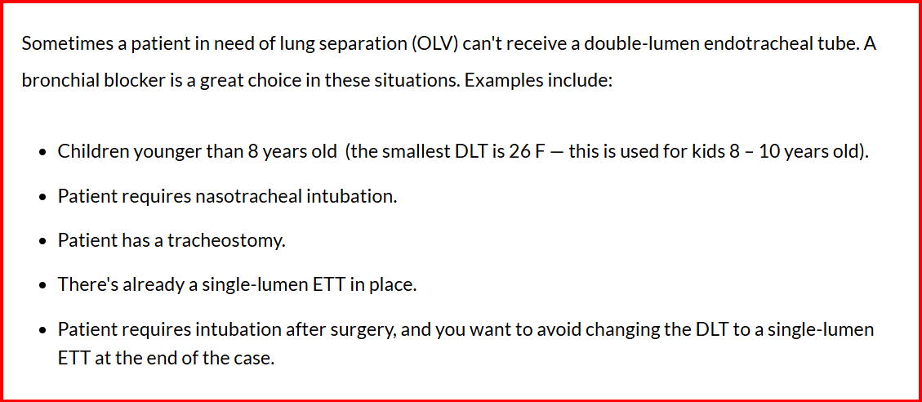
Indications for a Bronchial Blocker

Slide 11

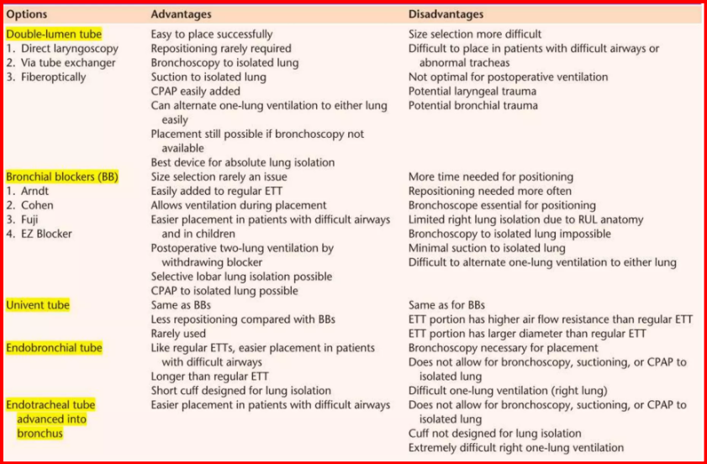

Slide 12
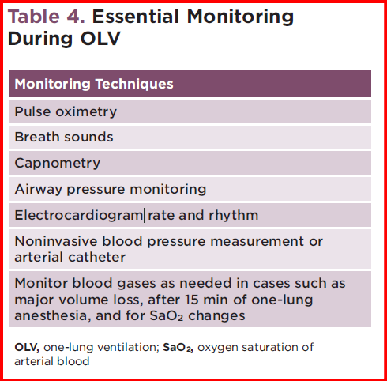
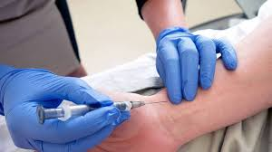
Essential monitoring During One lung Ventilation

Slide 13
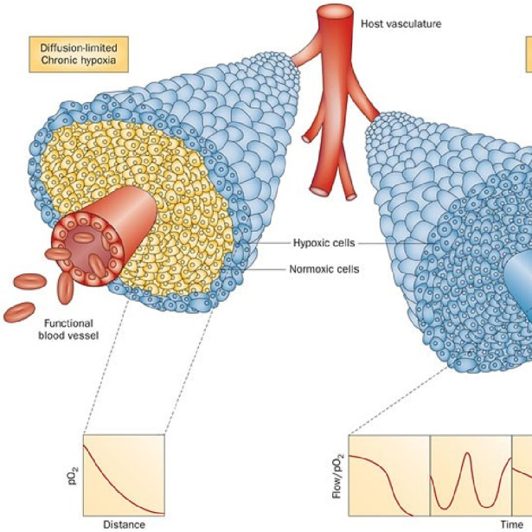
Management of Hypoxia during OLV
Increase FiO₂ to 100 percent
Optimize tidal volumes and peak inspiratory pressures
Check DLT or bronchial blocker placement with FOB
Suction airway as needed
Optimize cardiac output
Recruit ventilated lung and apply 5 cm of H2O PEEP
Apply 5 to 10 cm H2O CPAP to the nonventilated lung thereby decreasing shunt
Consider a return to two- lung ventilation

Slide 14
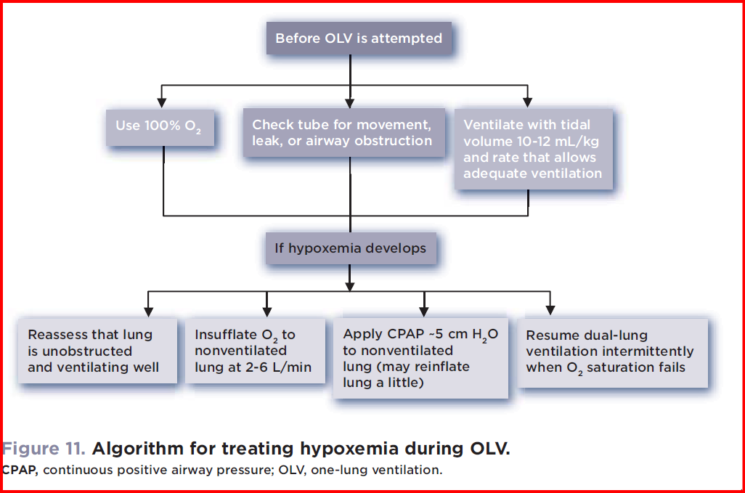
Algorithm of treating hypoxemia during OLV

Slide 15
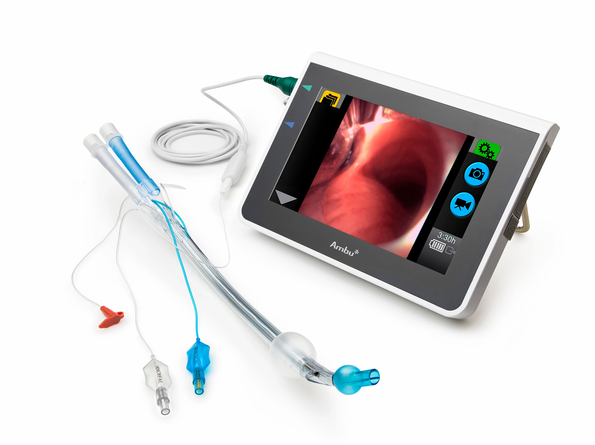
Complications of OLV
Tube mispositioning- the tubes can migrate during patient positioning.
Tracheobronchial injury due to tube trauma
Cuff hyperinflation can cause mucosal ischemia
Hypoxemia due to V/Q mismatch
Hemodynamic instability

Slide 16
References
Hensley, F.A., Martin, D.E., & Gravlee, G.P. (2012). A Practical approach to cardiac anesthesia. 5Th Ed
Hines, R.L. & Marshall, K.E. (2012). Stoelting’s Anesthesia and co-existing diseases. 6th Ed
Miller, R.D., Cohen, N.H., Eriksson, L.I., Fleisher, L.A., Wiener-Kronish, J.P. & Young, W.L. (2015). Miller’s Anesthesia. 8th Ed. Elsevier Saunders, Philadelphia, PA
Kaplan, J.A., Augoustides, J.G.T., Manecke, G.R., Maus, T.M., Reich, D.L. (2017) Kaplan’s Cardiac Anesthesia. 7th Ed. Elsevier, Philadelphia, PA

